Slide 1



Department of Computer Science and Engineering
Time Series - Stock Price Prediction using Boosting algorithm ML Model
KUMARESWAAR M - 211420104142
KRISHNAKUMAR M - 211420104139
JAYAKUMAR S - 211420104109
Guide Name & Designation
Dr.T.A.MOHANAPRAKASH ,
M.Tech, Ph.D
Coordinator Name & Designation
Dr.G.SENTHILKUMAR, M.C.A.,M.Phil.,M.E.,M.B.A.,Ph.D

Slide 2
_{Abstract:}
This study delves into the future landscape of stock price forecasting in stock markets, emphasizing the pivotal role of advanced Machine Learning (ML) techniques for precise AI-driven stock predictions. Leveraging sophisticated ML methodologies, this approach aims to bolster predictive models without explicitly mentioning specific algorithms. Advancements in ML models, real-time data processing, alternative data sources, and robust risk management strategies are pivotal factors driving improved AI-based stock predictions. However, it remains essential to complement AI-generated insights with comprehensive financial analysis and ensure ethical compliance in AI-driven wealth forecasting, given the inherent unpredictability of financial markets.

Slide 3
Introduction:
The introduction of advanced Machine Learning (ML) methodologies has revolutionized stock price forecasting in stock markets, presenting a promising avenue for accurate AI-driven predictions. This introduction sets the stage for exploring the transformative potential of ML techniques in predicting stock market trends without specifying particular algorithms. By harnessing the power of ML, this approach aims to revolutionize wealth forecasting, emphasizing the importance of technological advancements, real-time data processing, alternative data sources, and risk management strategies. It also highlights the need for comprehensive financial analysis and ethical considerations in navigating the dynamic and unpredictable landscape of financial markets.

Slide 4
Objective:
The future of stock market price forecasting relies on advanced Machine Learning (ML) models, including deep learning and sentiment analysis. ML-driven improvements, real-time data processing, and robust risk management will enhance AI-based stock predictions. Yet, balancing AI insights with comprehensive financial analysis and ensuring ethical compliance remain crucial due to market unpredictability.

Slide 5
LITERATURE SURVEY
Title: A LSTM-based method for stock returns prediction: A case study of China stock market.
Author: Kai Chen,Yi Zhou and FangyanDai
Year: 2022
A LSTM-based Method for Stock Returns Prediction: A Case Study of China Stock Market" by Kai Chen, Yi Zhou, and Fangyan Dai presents an approach using Long Short-Term Memory (LSTM) networks for predicting stock returns. LSTM networks are highlighted for their ability to capture long-term dependencies, particularly useful in time series prediction tasks like stock market forecasting. The paper likely details the training process of the LSTM network using historical China stock market data, aiming to predict future returns.

Slide 6
Title:Prediction of Stock Market Using Artificial Neural Network
Author: Neelima Budhani,Dr. C. K.Jha,Sandeep K.Budhani
Year: 2022
Prediction of Stock Market Using Artificial Neural Network" by Neelima Budhani, Dr. C.K. Jha, and Sandeep K. Budhani is likely a study focusing on using Artificial Neural Networks (ANNs) for stock market prediction. This paper, authored by the mentioned researchers, might delve into the application of ANNs, a type of machine learning algorithm inspired by the human brain's structure, to forecast stock market movements. Expect discussions on how ANNs can analyze historical market data to identify patterns and trends for predictive purposes.

Slide 7
_{Existing system:}
The existing systems for stock price forecasting in stock markets involve statistical, quantitative, technical, and fundamental analysis, complemented by expert opinions and news analysis. However, these methods face challenges in adapting to market complexities, unexpected events, and may struggle to consistently outperform the market due to the efficient market hypothesis. There's a growing need to explore more advanced Machine Learning (ML) techniques and diverse data integration to enhance accuracy and adaptability in predicting market trends.

Slide 8
_{Disadvantage:}
Limitations in Adaptability
Complexity in Predictive Accuracy
Risk of Financial Loss
Inadequate Integration of Advanced Techniques

Slide 9
_{Proposed system:}
The proposed system for improved stock price forecasting in stock markets integrates advanced Machine Learning (ML) techniques, alternative data sources, real-time analysis, and ethical compliance. By employing sophisticated ML algorithms, embracing diverse datasets, ensuring adaptability to changing market conditions, and focusing on transparency and ethical considerations, the system aims to enhance accuracy and reliability in predicting market trends and wealth forecasting.
Advantages:
Enhanced Accuracy
• Improved Decision-making
• Enhanced Safety
• Early Detection
• Real-time Data Processing

Slide 10
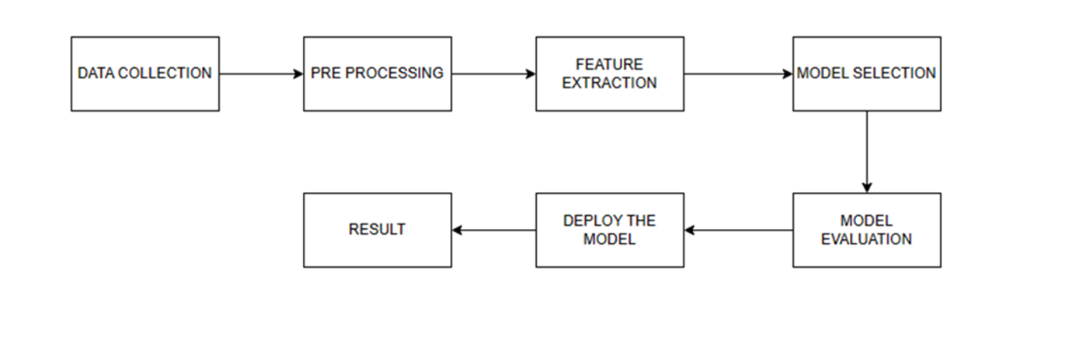
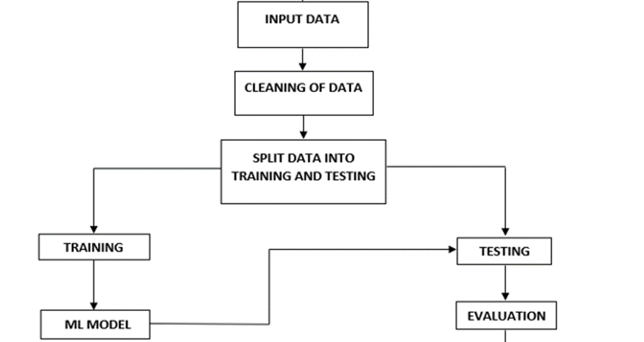
_{System Architecture:}

Slide 11
Software requirements:
Python
Anaconda Navigator
Python built-in modules
Numpy
Pandas
Matplotlib
Sklearn
Seaborm

Slide 12
Hardware requirements:
OS – Windows 7, 8 and 10 (32 and 64 bit)
RAM – 4GB
Explantion:
This specification outlines the minimum system requirements for running the software on different versions of the Windows operating system. It indicates compatibility with Windows 7, 8, and 10, both 32-bit and 64-bit editions. Additionally, it specifies a minimum RAM (Random Access Memory) requirement of 4GB, ensuring smooth performance and adequate memory allocation for the software to operate effectively on these systems.

Slide 13
ALGORITHMS USED:
Boosting Algorithms:
Boosting algorithms are a class of machine learning techniques that aim to enhance the predictive performance of models by combining the strengths of multiple weak learners. Weak learners, often simple decision trees, are sequentially trained on the data, with each subsequent learner focusing on the mistakes of its predecessors. The key idea is to assign higher weights to misclassified instances, thereby emphasizing their importance in subsequent iterations. Gradient Boosting, AdaBoost, and XG Boost are popular boosting algorithms. Gradient Boosting optimizes model errors by minimizing the gradient of the loss function, AdaBoost assigns varying weights to instances based on their classification success, and XG Boost extends these concepts with regularization and parallel processing capabilities. Boosting algorithms excel in improving predictive accuracy and are widely utilized in diverse machine learning applications.

Slide 14
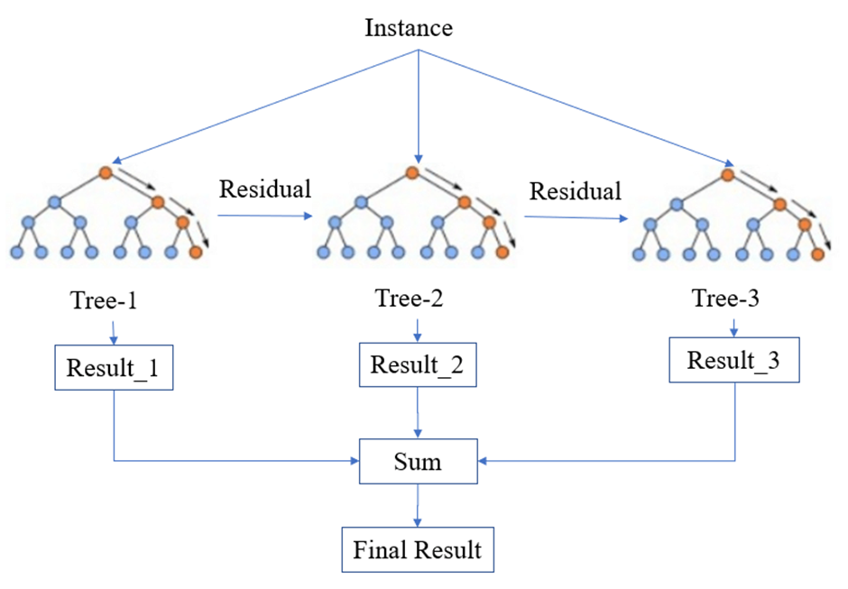
Algorithm Architecture:

Slide 15
_{Conclusion:}
The proposed system, leveraging advanced Machine Learning (ML) and diverse data sources, promises enhanced stock price forecasting in stock markets. Through sophisticated algorithms, real-time adaptability, and ethical compliance, this approach aims to significantly improve accuracy and reliability in predicting market trends and wealth outcomes.

Slide 16
_{Future Enhancement:}
Future enhancements for the project may include implementing advanced deep learning techniques for more accurate predictions, integrating natural language processing (NLP) for sentiment analysis from news and social media, incorporating blockchain technology for transparent and secure data transactions, expanding the platform to support additional financial instruments such as cryptocurrencies and commodities, enhancing user personalization features based on historical trading behavior, and leveraging cloud computing for improved scalability and performance. Additionally, exploring emerging technologies like quantum computing for even more sophisticated analysis and prediction capabilities could be considered for future development.

Slide 17
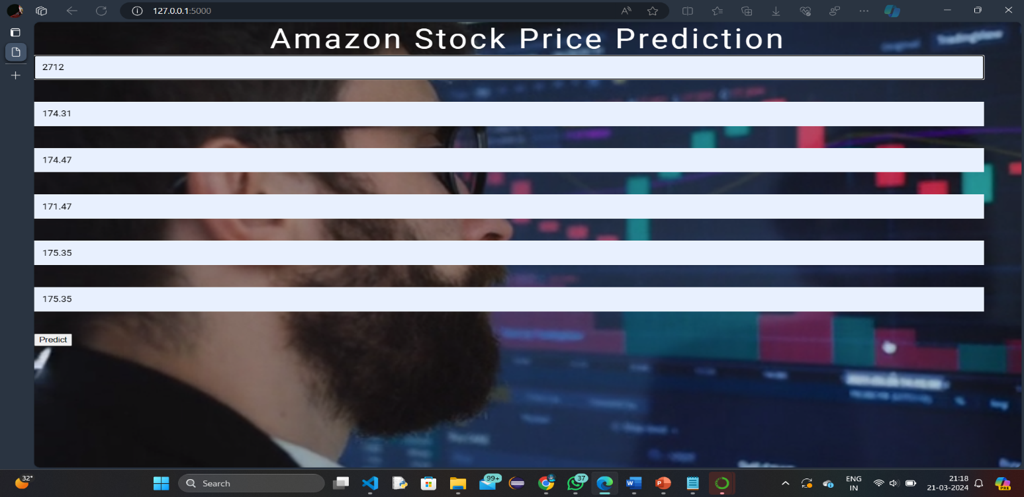
Screenshot:

Slide 18
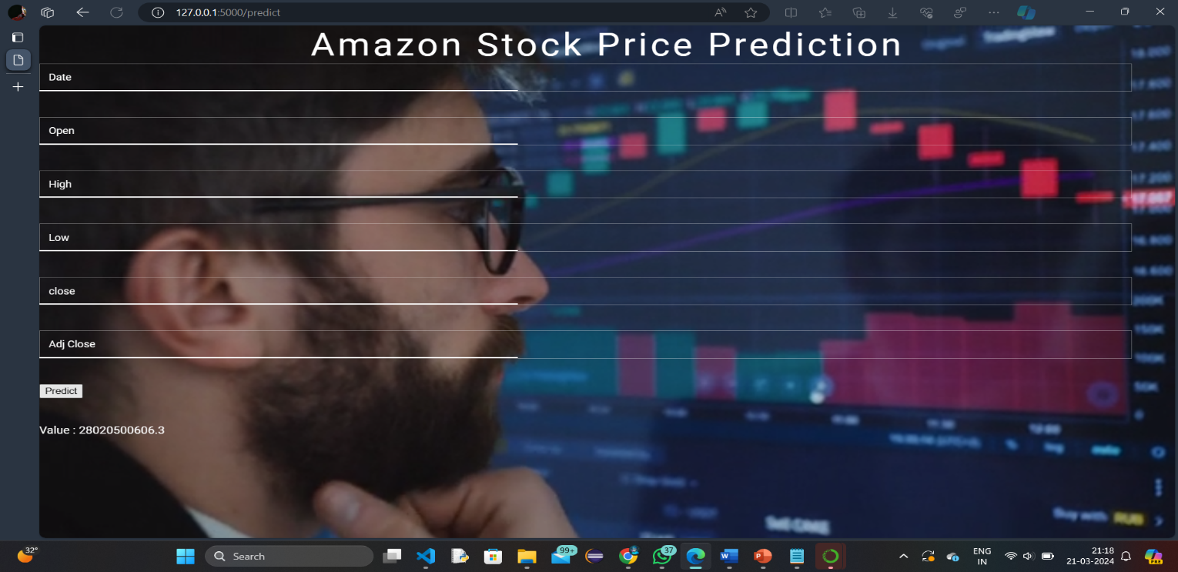
Screenshot:

Slide 19
_{Reference:}
[1] RakhiMahant, TrilokNathPandey, Alok Kumar Jagadev, and SatchidanandaDehuri ―Optimized Radial Basis Functional Neural Network for Stock Index Prediction,‖ International Conference on Electrical, Electronics, and Optimization Techniques (ICEEOT) - 2016.
[2] Kai Chen, Yi Zhou and FangyanDai ―A LSTM-based method for stock returns prediction: A case study of China stock market,‖ IEEE International Conference on Big Data,2015.
[3] A.U.S.S Pradeep, SorenGoyal, J. A. Bloom, I. J. Cox, and M. Miller, ―Detection of statistical arbitrage using machine learning techniques in Indian Stock market,‖ IIT Kanpur, April 15, 2013.
[4] Prashant S. Chavan, Prof. Dr. Shrishail. T. Patil ―Parameters for Stock Market Prediction,‖ Prashant S Chavan et al, Int.J.Computer Technology & Applications, Vol 4 (2),337-340.
[5] NeelimaBudhani, Dr. C. K. Jha, Sandeep K. Budhani―Prediction of Stock Market Using Artificial Neural Network,‖ International Conference on Soft Computing Techniques for Engineering and Technology (ICSCTET)- 2014. [6] SharvilKatariya, Saurabh Jain―Stock Price Trend Forecasting using Supervised Learning Methods.
[7] DhirajMundada, GauravChhaparwal, SachinChaudhari, and TruptiBhamare― Stock Value Prediction System,‖ International Journal on Recent and Innovation Trends in Computing and Communication, April 2015
[8] Hochreiter, Sepp, and Jürgen Schmidhuber― Long short-term memory,‖ Neural computation 9.8 (1997): 1735-1780

Slide 20
THANK YOU…

